Slide 1

Minor Project-I On
“ Vehicle Showroom Administration”
Mahakal Institute of Technology
Department of Computer Science and Engineering
Presented By:
Gourav Shrinivas
0704CS171049
Harsh Patel
0704CS171055
Durgesh Jaiswal
0704CS171047
  Under the guidance of:
  Prof. Sharad Morolia
14/10/2019

Slide 2
Contents
Introduction
Literature Review
Problem Statement
Analysis Overview
Design Overview
System Database Structure
Screenshots
Limitations & Future Scope
Conclusion
References
14/10/2019

Slide 3
Introduction
The “Vehicle Showroom Administration” has been developed to override the problems existing in the practicing manual system. This system is designed for the particular need of the company to carry out operations in a smooth and effective manner.
Every organization, whether big or small, has challenges to overcome and managing the information of booking, Vehicle Showroom, Vehicle, Payment, Registration. Every Vehicle Showroom System has different Vehicle Showroom needs. This System is designed to assist in strategic planning, and will help you ensure that your organization is equipped with the right level of information and details for your future goals.
14/10/2019

Slide 4
Literature Review
1. STUDY OF GARAGE MANAGEMENT SYSTEM
The Objective of “Garage Management System" is to manage details of Garage like Customer Details, Stock Details, Employee Details, Car Entrance and Exit Information ,Stock Report.
Disadvantage
It doesn’t store repairing and servicing data, which means it doesn’t contain the details of what is the repair work has to be done in customer car.
It does not contain the details of how much money has to be taken from customer and what’s the total repair work cost.
The software does not have the list, details and cost of number of gadgets and accessories their garage contain.
14/10/2019

Slide 5
Advantage
The user interface of the System is very interactive and user friendly.
The System also shows the profit status chart which makes it easy and more understandable to make an immediate analysis and to understand profit information quickly.
2. STUDY OF VEHICLE MANAGEMENT SYSTEM
The Objective of “Vehicle Management System" is to manage details of Showroom like Customer Details, Stock Details, Employee Details, Vehicle Details .
Disadvantage
It doesn’t have report generation module. It means there is no Quotation generate ,bill generate feature in this system..
14/10/2019

Slide 6
It does not store dealership details. This means there is no detail from what Dealership Company the vehicle has imported.
The system has poor user interface, which means it is not user friendly.
Advantage
The advantage of Vehicle Showroom Management is that it’s very easy to manage all the employee, customer, and vehicle details.
It’s easy to update, delete and retrieve information.
3. STUDY OF HYBRID AUTOMOBILES
Hybrid Automobiles is professional desktop application software for vehicle showroom management. Hybrid Automobiles is designed so simple
14/10/2019

Slide 7
that an average computer user can use it.
Advantage
This software provides all functionalities to manage a vehicle showroom. Some of the features include Inventory Management, Customer Management, Sales and Deals, Customer Installments, Report Printing, User Management, Custom Watermark, Vehicle Expense Tracker and many more.
We hardly found any limitation in this software, but we tried to analyze and study this software and try to include some features of this software in our project.
14/10/2019

Slide 8
Problem Statement
The old manual system was suffering from the series of drawbacks. The whole system is maintained by hand process to keep records.
If any information was to be found it was required to go through the different registers, documents.
It was very difficult to find errors while entering the records and once the records were entered it was very difficult to update these records.
It is difficult to keeping, maintaining and retrieving the information was very tedious and lengthy.
14/10/2019

Slide 9
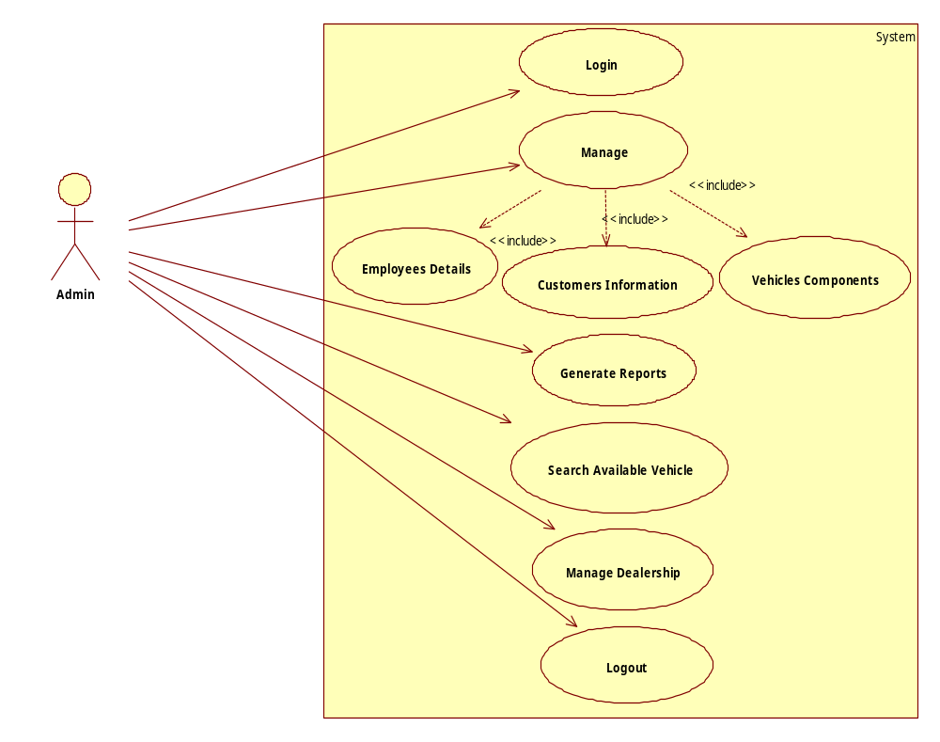
Use Case Diagram
Analysis Overview
14/10/2019

Slide 10
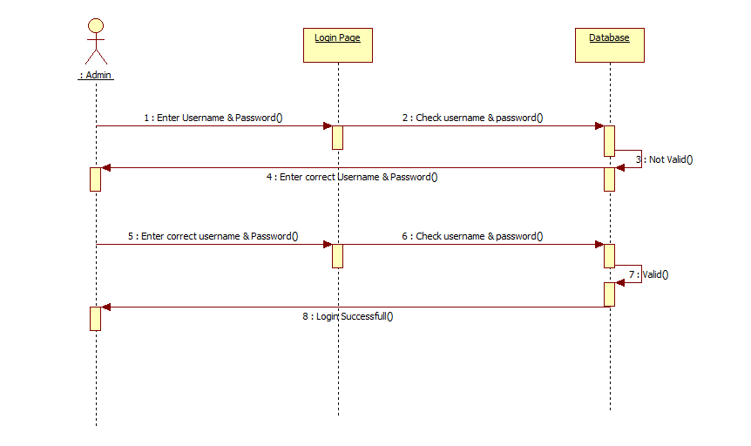
Login Sequence Diagram
14/10/2019

Slide 11
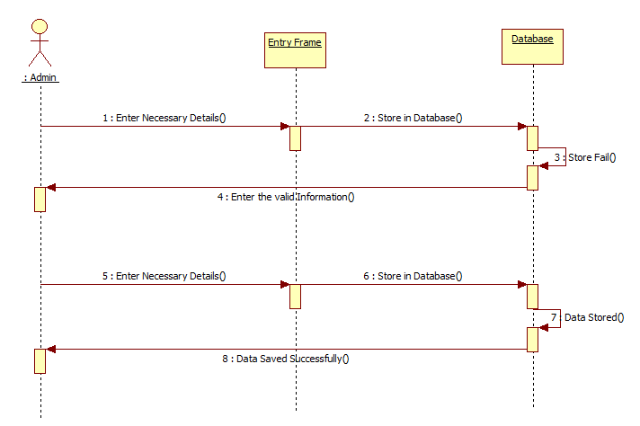
Manage Sequence Diagram
14/10/2019

Slide 12
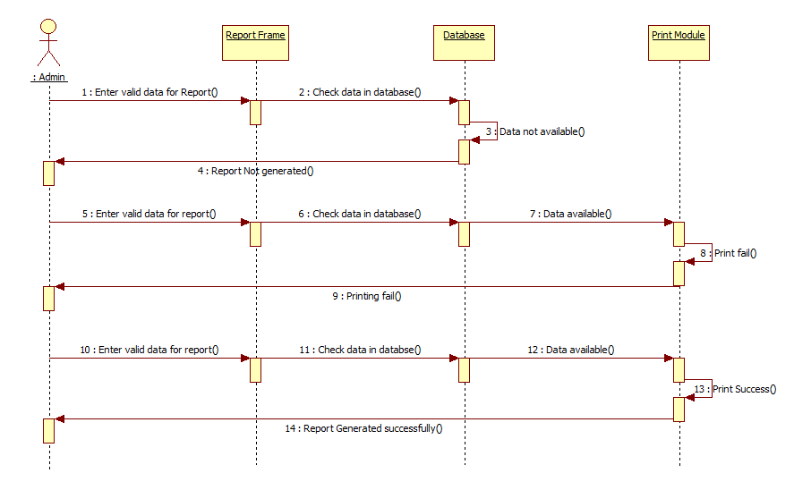
Report Sequence Diagram
14/10/2019

Slide 13
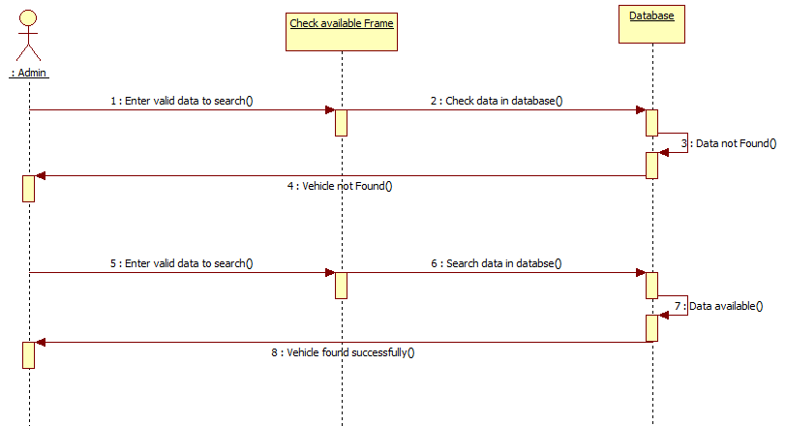
Search Sequence Diagram
14/10/2019

Slide 14
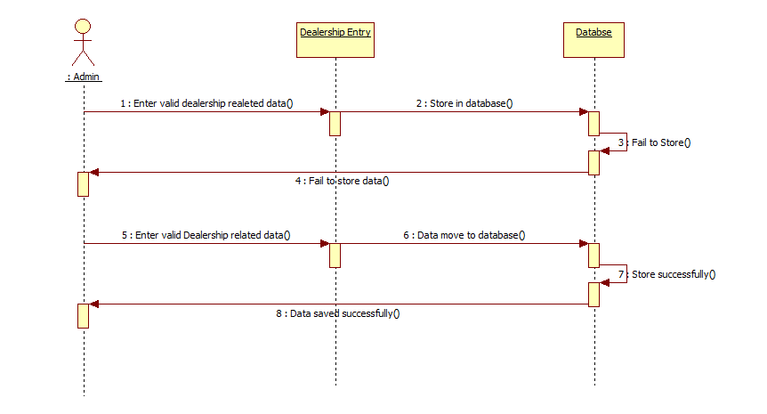
Dealership Sequence Diagram
14/10/2019

Slide 15
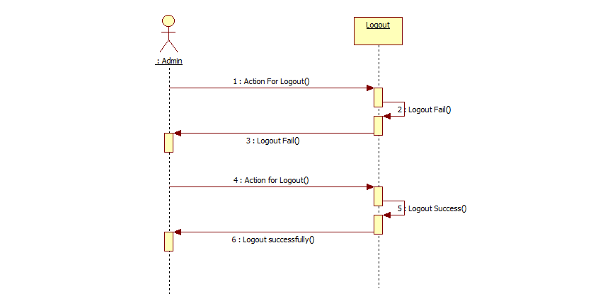
Logout Sequence Diagram
14/10/2019

Slide 16
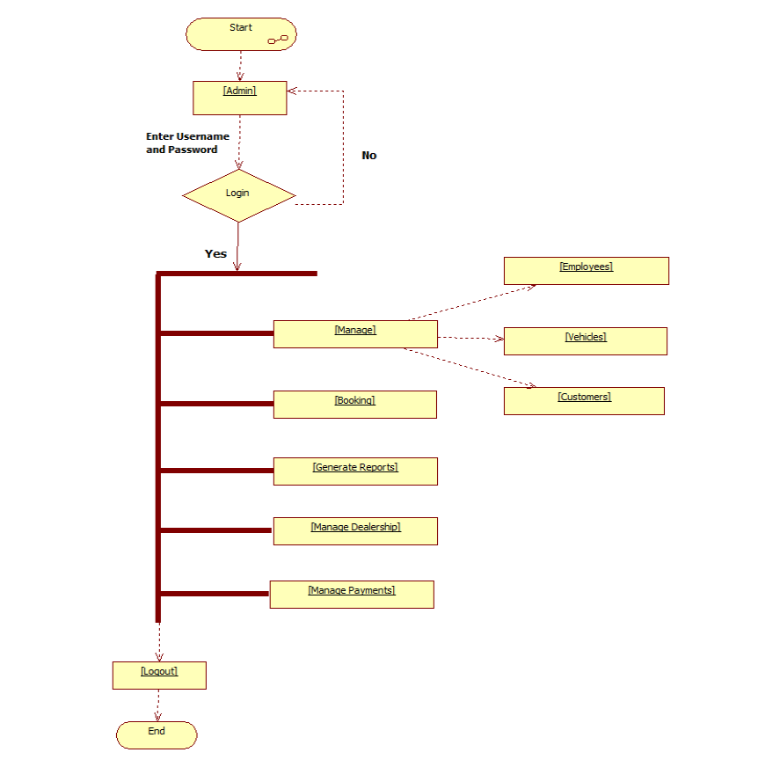
System Flow Diagram
14/10/2019

Slide 17
Design Overview
Data Dictionary Diagram
Table Name | Customer
Description | This table provide the information about Customer.
Primary Key | cid
Foreign Key | ---
S.No | Data Value | Data Type | Description
1 | cid | Int(11) | It store Customer Id.
2 | cname | Varchar(50) | It store Customer name.
3 | cfathername | Varchar(50) | It store father’s name.
4 | mobnumber | Varchar(20) | It store Mobile Number.
5 | caddress | Varchar(100) | It store Address.
6 | ccity | Varchar(50) | It store City name.
7 | cemail | Varchar(50) | It store Email id.
8 | caddharno | Varchar(20) | It store Aadhar Number.
9 | cpannum | Varchar(20) | It store PAN number.
10 | cgender | Varchar(10) | It store Gender name.
11 | cdob | date | It store Date of Birth
12 | cvehino | Varchar(20) | It store vehicle number.
14/10/2019

Slide 18
Table Name | Employee
Description | This table provide the information about Employee.
Primary Key | emplyid
Foreign Key | ---
S.No | Data Value | Data Type | Description
1 | ename | Varchar(50) | It store employee name.
2 | efathername | Varchar(50) | It store father’s name.
3 | emobnumber | Varchar(50) | It store mobile number.
4 | eaddress | Varchar(20) | It store address.
5 | ecity | Varchar(100) | It store city name .
6 | eemail | Varchar(100) | It store Email id.
7 | eaddharno | Varchar(50) | It store aadhar number.
8 | epannum | Varchar(20) | It store PAN number.
9 | egender | Varchar(100) | It store gender
10 | edob | date | It store date of birth
11 | edateofjoin | date | It store date of joining
12 | esalary | Int(15) | It store salary
13 | emplyid | Int(10) | It store employee id
14 | designation | Varchar(100) | It store designation.
14/10/2019

Slide 19
Table Name | Vehicle
Description | This table provide the information about Vehicle.
Primary Key | chsno
Foreign Key | ---
S.No | Data Value | Data Type | Description
1 | chsno | Int(10) | It store vehicle number.
2 | engno | Int(10) | It store engine number.
3 | color | Varchar(50) | It store vehicle colour.
4 | cost | Bigint(20) | It store vehicle cost.
5 | dateofentry | date | It store date of entry .
6 | modnam | Varchar(100) | It store model name.
7 | cmpnynam | Varchar(50) | It store company name.
8 | milage | Int(10) | It store vehicle milage.
9 | topsp | Int(10) | It store top speed.
10 | fueltyp | Varchar(20) | It store vehicle fuel type.
11 | delid | Int(10) | It store dealer id.
12 | status | Varchar(10) | It store vehicle status.
14/10/2019

Slide 20
Table Name | Sale
Description | This table provide the information about sale.
Primary Key | sid
Foreign Key | ---
S.No | Data Value | Data Type | Description
1 | sid | Int(10) | It store sale id.
2 | vehid | Int(10) | It store vehicle id.
3 | cstid | Int(10) | It store customer id.
4 | empid | Int(10) | It store employee id.
5 | vehicost | Int(20) | It store vehicle cost.
6 | purchdate | date | It store date of purchase.
7 | depamnt | Int(10) | It store deposit amount.
8 | remamnt | Int(10) | It store remaining amount.
9 | delvdate | date | It store delivery date.
10 | paymode | Varchar(20) | It store payment mode.
14/10/2019

Slide 21
Table Name | Dealer
Description | This table provide the information about Dealer.
Primary Key | delid
Foreign Key | ---
S.No | Data Value | Data Type | Description
1 | dname | Varchar(50) | It store Dealer Id.
2 | compnynam | Varchar(50) | It store Company name.
3 | smobnum | Varchar(50) | It store mobile number.
4 | demail | Varchar(20) | It store email id.
5 | daddress | Varchar(100) | It store Address.
6 | delid | Int (10) | It store Dealer’s id.
7 | dcity | Varchar(50) | It store city name.
8 | ladnum | Varchar(20) | It store landline number.
14/10/2019

Slide 22
Table Name | Bill
Description | This table provide the information about Bill entry.
Primary Key | bilid
Foreign Key | ---
S.No | Data Value | Data Type | Description
1 | bilid | Int(11) | It store Bill id.
2 | sid | Int(11) | It store Sale id
3 | cid | Int(11) | It store Customer id
4 | chsno | Int(11) | It store Vehicle Number.
5 | emplyid | Int(11) | It store Employee id.
6 | bdate | Date | It store Bill date.
14/10/2019

Slide 23
Table Name | Login
Description | This table provide the information about Login.
Primary Key | username
Foreign Key | ---
S.No | Data Value | Data Type | Description
1 | username | Varchar(20) | It store user name.
2 | password | Varchar(10) | It store password.
3 | aname | Varchar(50) | It store admin name.
14/10/2019

Slide 24
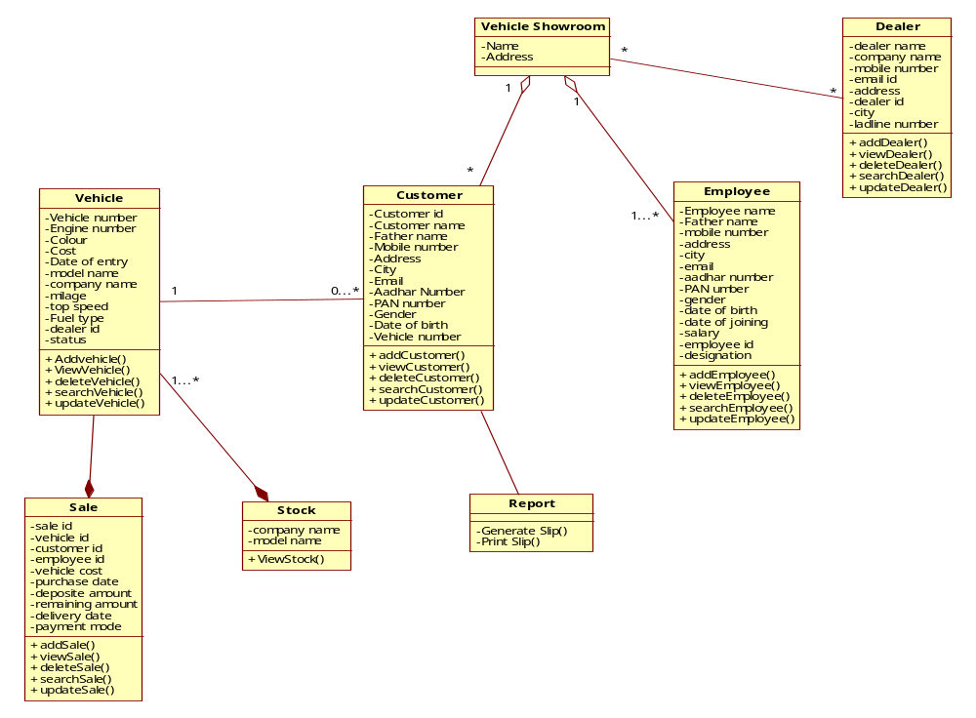
Class Diagram
14/10/2019

Slide 25
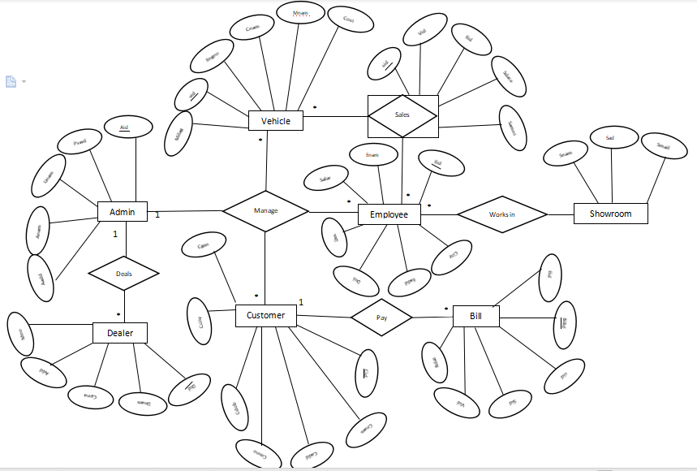
E-R Diagram

Slide 26
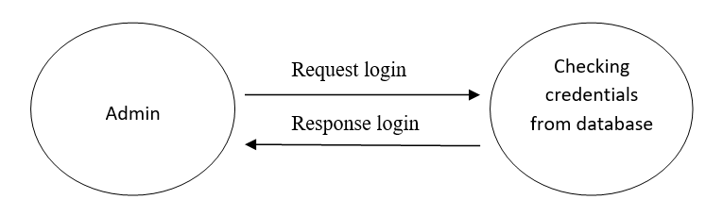
Data Flow Diagram
0 Level DFD
14/10/2019

Slide 27
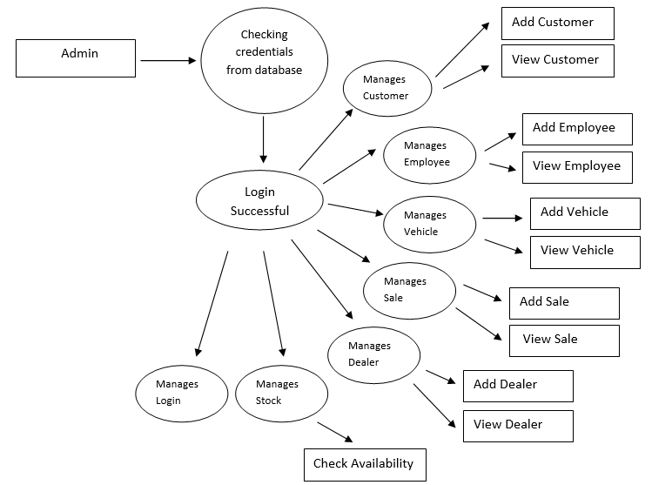
Data Flow Diagram
1 Level DFD
14/10/2019

Slide 28
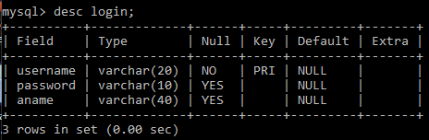
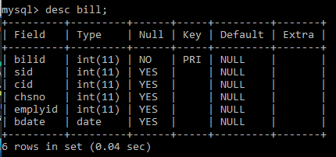
System Database Structure
Login table
Bill table
14/10/2019

Slide 29
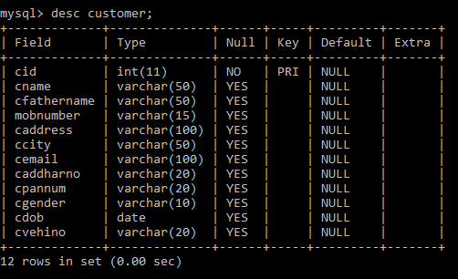
Customer table
14/10/2019

Slide 30
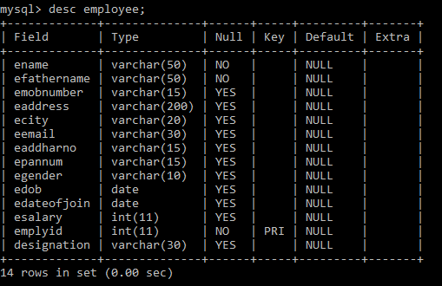
Employee table
14/10/2019

Slide 31
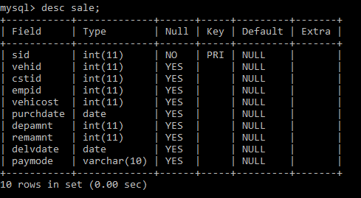
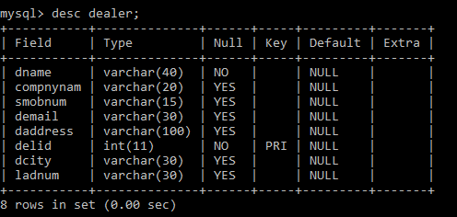
Sale table
Dealer table
14/10/2019

Slide 32
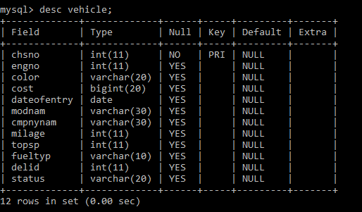
Vehicle table
14/10/2019

Slide 33
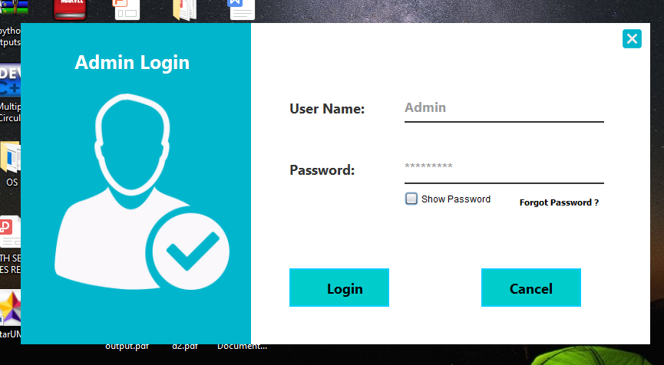
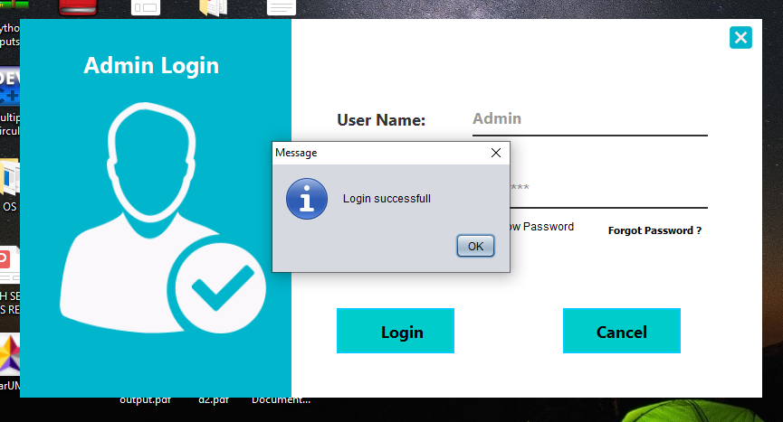
Screenshots

Slide 34
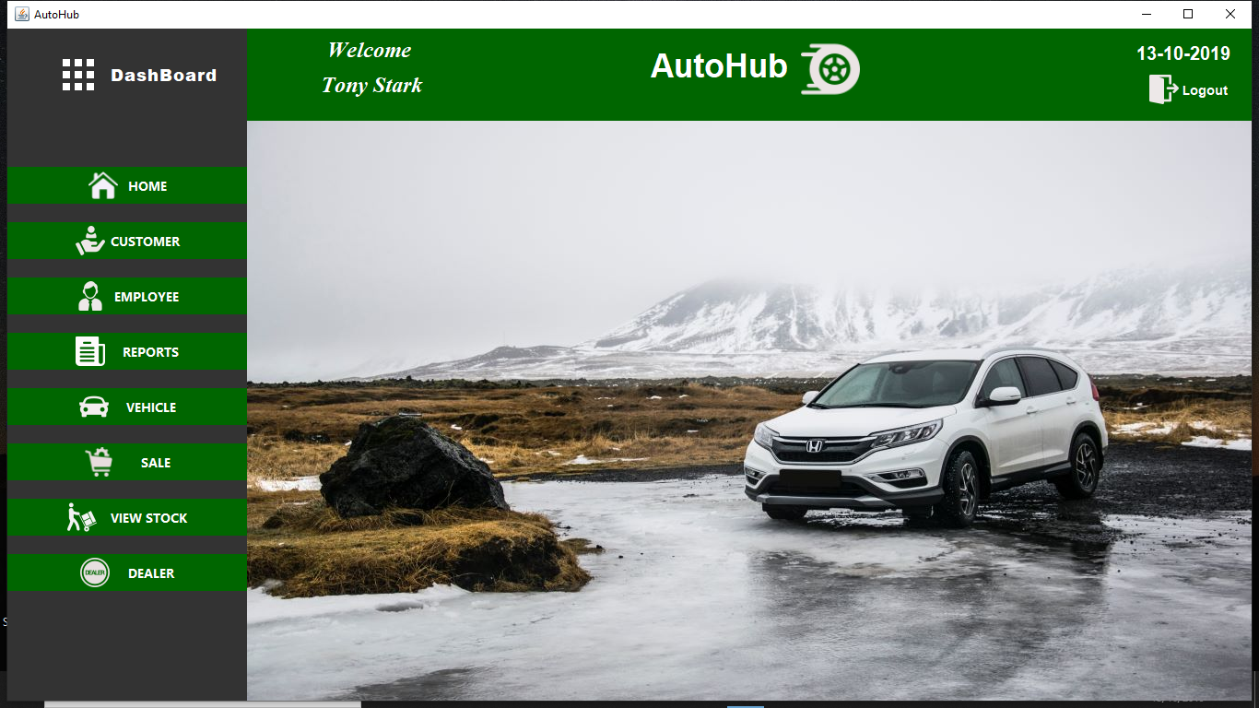
Home Screen
14/10/2019

Slide 35
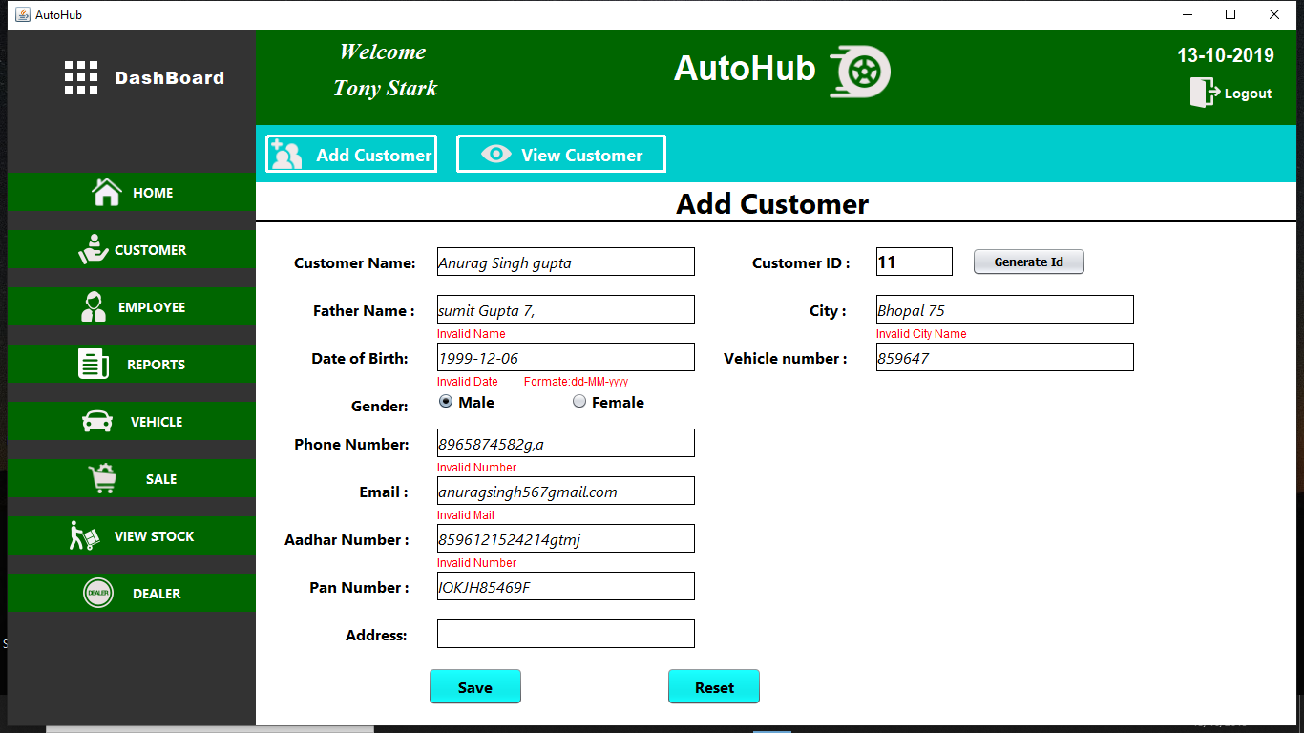
14/10/2019

Slide 36
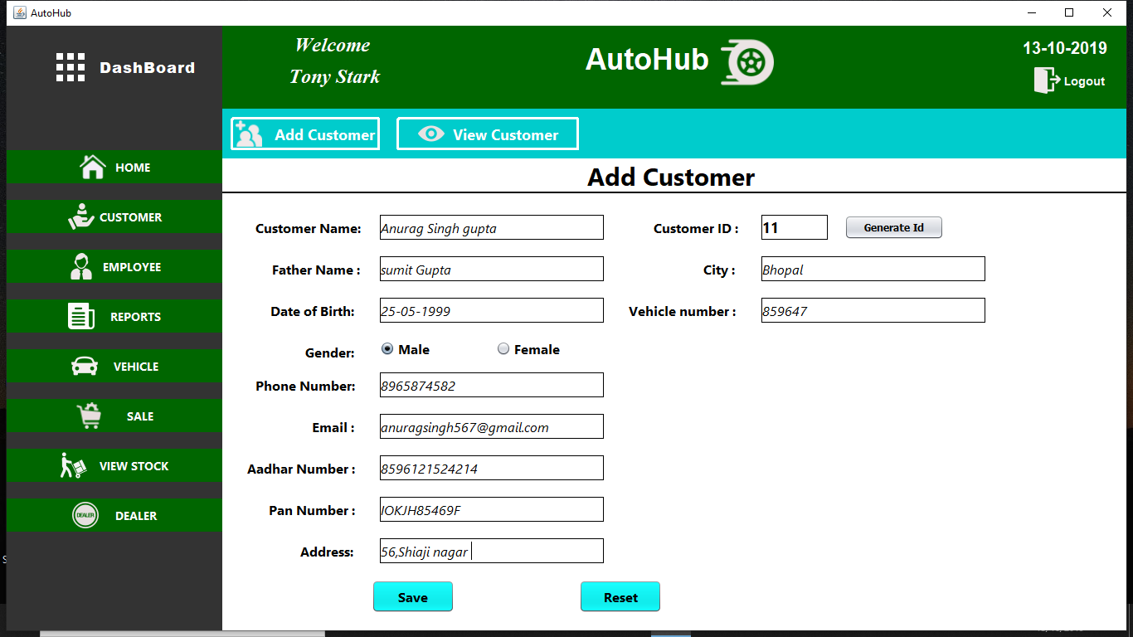
14/10/2019

Slide 37
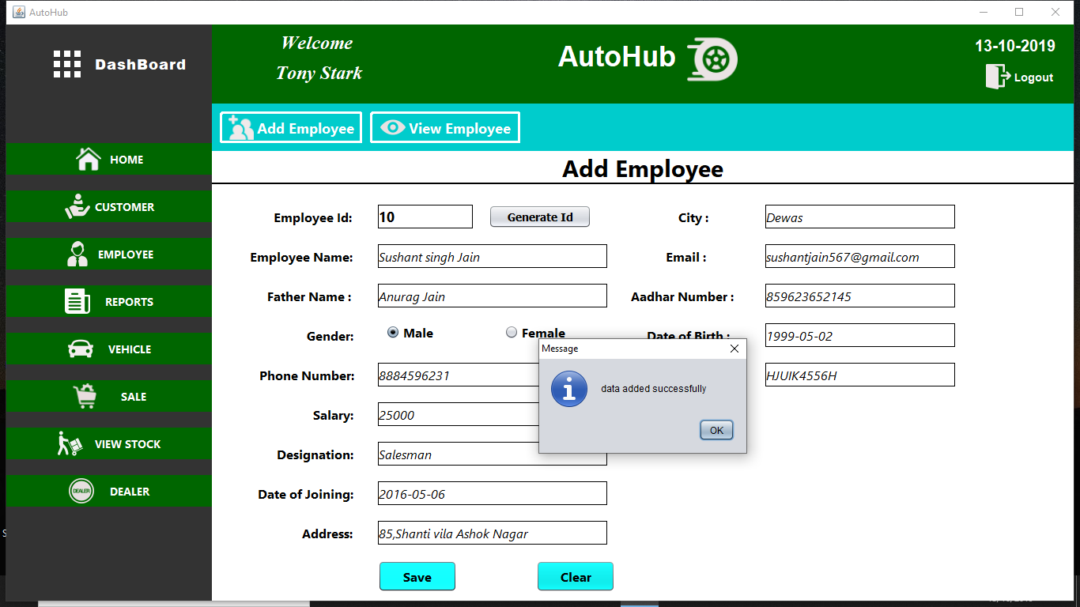
14/10/2019

Slide 38
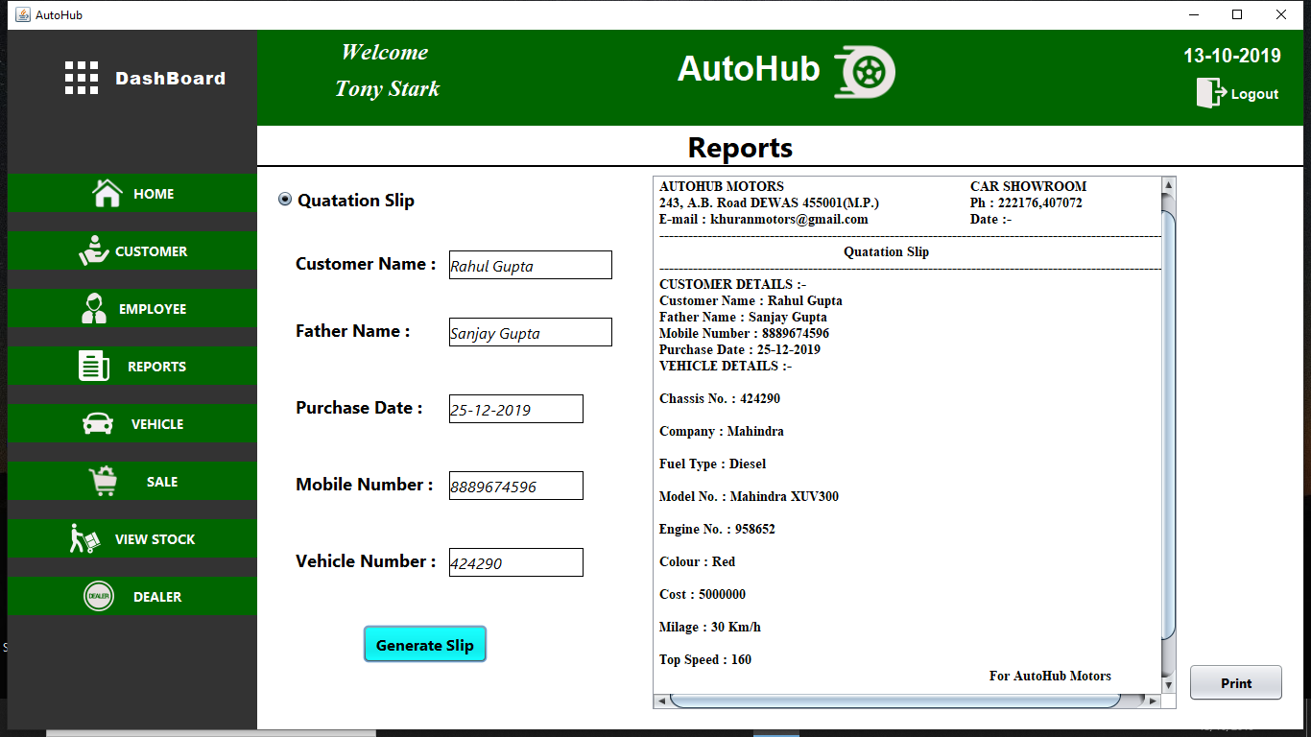
14/10/2019

Slide 39
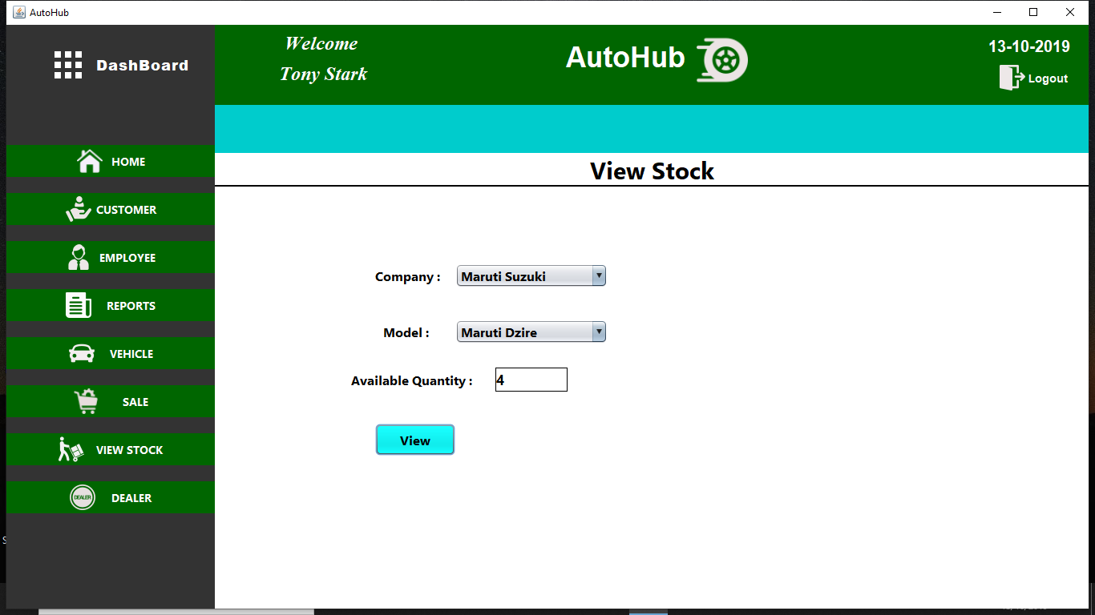
14/10/2019

Slide 40
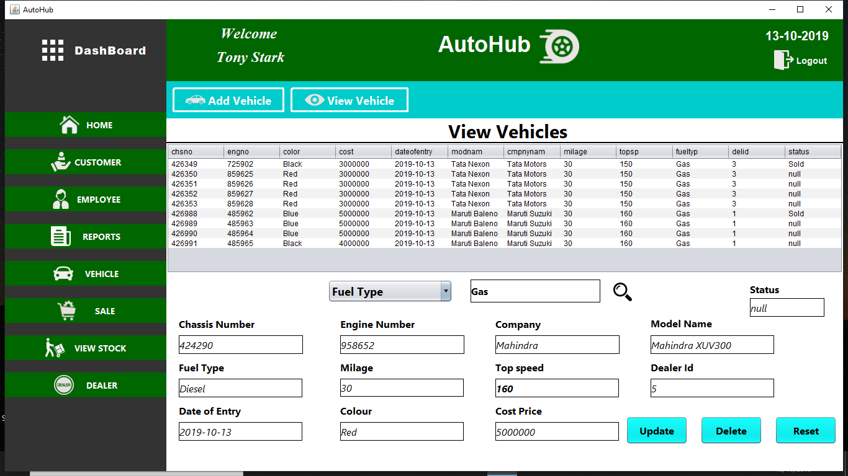
14/10/2019

Slide 41
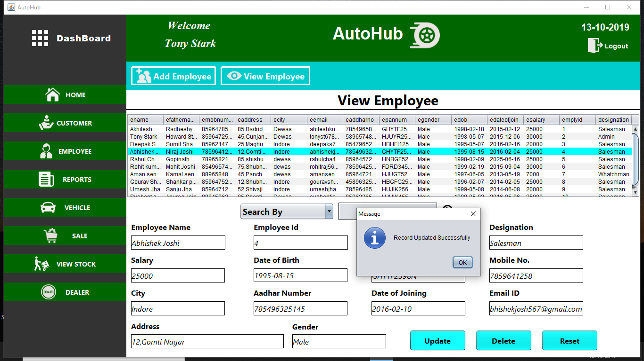
14/10/2019

Slide 42
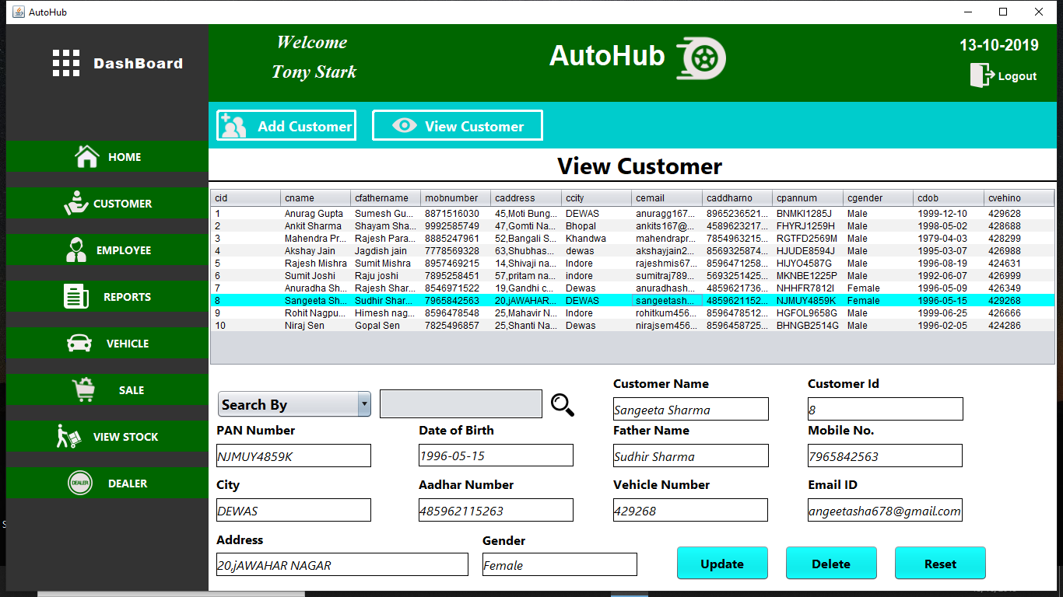
14/10/2019

Slide 43
Limitation and Future Scope
Although We have put our best efforts to make the software flexible, easy to
operate but limitation cannot be ruled out .Though the software presents many
options but some options could not be covered; because of logistic and
complexity and Lack of time was also major constraint.
List of limitations which is available in the Vehicle Showroom Administration:
Vehicle Showroom Administration Software does not manage Online Payment System.
System does not show the Sale and Profit Status Chart .
It only generates the report on Quotation Slip.
14/10/2019

Slide 44
Future Scope
We can give more advance software for Vehicle Showroom Administration including more facilities.
We can add printer in future.
Implement the backup mechanism for taking backup of database on regular basis.
We can add online payment module.
We can develop web application or android application for vehicle showroom administration.
14/10/2019

Slide 45
Conclusion
In the past where every activity concerning vehicle showroom is limited to manual handling only. Today all these activities are reshaped by the power of internet and technology. Nowadays we can manage all Vehicle Showroom related activities with just few clicks.
Hope our Software Vehicle Showroom Administration will prove to be a helpful and powerful software for Vehicle Showrooms .
14/10/2019

Slide 46
References
[1] Abraham Silberschatz, Henry F.Korth and S. Sudarshan, Database System Concepts. New York: McGraw Hill, 2006.
[2] R S.Pressman,Software Enginerring: A Practioner's Approch. Sixth edition 2006, McGraw Hill.
[3] Sayan Kumar Pal, “Software Development Life Cycle Models
,” https://www.geeksforgeeks.org/software-engineering-iterative-waterfall-model/.
[4] “Java Jar files Download,” http://www.java2s.com/Code/Jar/j/Downloadjcalendar14jar.htm.
[5] “ problem solving and error correction,” https://stackoverflow.com/.
[6] “My SQL Queries, ” https://www.w3schools.com/.
[7] https://www.javatpoint.com/.
[8] “Java Form validation,” https://www.journaldev.com/634/regular-expression-in-java-regex-example/.
[9] “Java Database Connectivity,” https://www.javatpoint.com/java-jdbc.
[10] “Icons and Images,” https://www.flaticon.com , https://unsplash.com/.
14/10/2019

Slide 47
Any Query ?
14/10/2019

Slide 48
Thank You
14/10/2019

